Slide 1
E-COMMERCE SALES DATA
ASSIGNMENT-13 Anamika Singh
BANA 6760 E01: DATA VISUALIZATION APRIL 16, 2021
UNIVERSITY OF COLORADO, DENVER

Slide 2
CONTENTS
OBJECTIVE
DATASET
DATA ANALYSIS TOOLS
EXPLORATORY DATA ANALYSIS
VISUALIZATIONS AND BUSINESS QUESTIONS
DASHBOARD
CONCLUSION

Slide 3
OBJECTIVE
The Objective of the project is to expand business by increasing the sales and revenue of the company and identifying business opportunities by answering business questions.

Slide 4
DATASET
E-commerce dataset from Kaggle. The dataset contains sales details from Indian E-commerce market. The dataset includes two excel files.
Orders- This file contains information on Order ID, Order Date, Customer Name, City and State. I selected this dataset as it contains geographical locations that will be plotted on map.
2) Order Details- This file contains information on Order ID, Amount, Profit, Quantity, Category and Sub-Category.
R.Ben. (2020) E-commerce Dataset. Kaggle
https://www.kaggle.com/benroshan/ecommerce-data?select=Sales+target.csv

Slide 5
DATA ANALYSIS TOOLS
R and Excel- I will use Excel to get the basic structure of the dataset. R will be used to perform EDA. It will help to find missing values, null values if present in the dataset.
Tableau- I will use Tableau to build visualizations, mapping dataset, preparing worksheets, Dashboard, and stories.
Power point- PowerPoint will be used to prepare presentation by adding text and dashboard.

Slide 6
EXPLORATORY DATA ANALYSIS
EDA will be performed on E-commerce Sales dataset using R to understand the structure and pattern of the dataset.
Dataset will be examined, and visualizations will be created to answer some of the business questions to improve sales and profit.
Missing Values- By using Summary function in R, it is disclosed that no variables have missing values in the dataset.
Erroneous data – Order date column has mixed date format. Changed it into standard single format using Lubridate package.

Slide 7
EXPLORATORY DATA ANALYSIS
Outliers- There are so many outliers present in the sales and profit dataset. It was determined by using Boxplot in R.
Correlation- By visualizing scatter plot between sales and profit using cor function in R, we saw that profit is not related to sales as the correlation is only 0.24.
Distribution- The histogram for sales data is highly right skewed, meaning mean is greater than the median. The histogram of the profit variable is left skewed. Some of the values in profit are in negative.

Slide 8
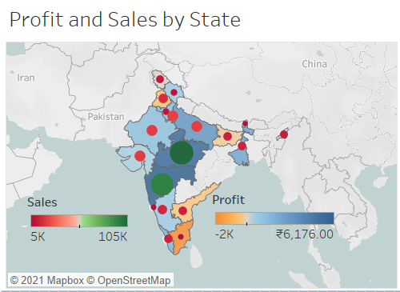
VISUALIZATIONS AND BUSINESS QUESTIONS
Question 1
What are the sales and profit by each state?
Map visualization is created using latitude and longitude automatically generated by Tableau.
Map represents Sales and Profit by state. Color gradient is used to represent the profit and circle size represents sales.
We can observe that Maharashtra and Madya Pradesh have high sales and profits.

Slide 9
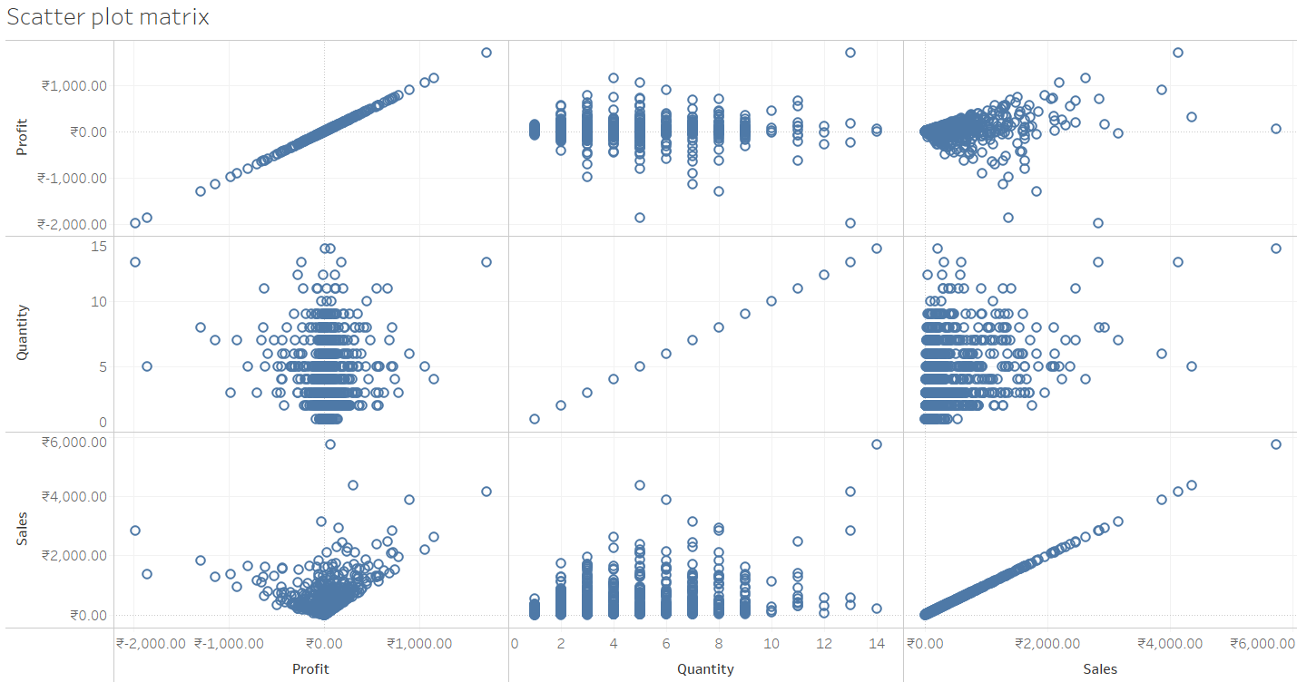
VISUALIZATIONS AND BUSINESS QUESTIONS
Question 2
What is the relationship among Profit, Sales, and Quantity?
The Scatterplot Matrix shows the relation among the three variables.
We can see that there is a weak relationship between sales and profit and quantity as the matrix does not show any linear line.

Slide 10
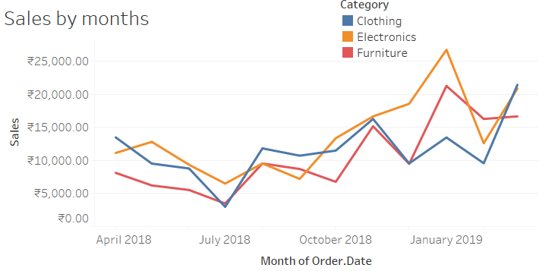
VISUALIZATIONS AND BUSINESS QUESTIONS
Question 3
What are the sales by each category over months?
Line graph represents Sales over months by category.
We can observe that sales of all the three products are increasing over months.
In January 2019 sales are the highest for the E-commerce company.
In July we can see a dip in the company sales for Clothing and Furniture.

Slide 11
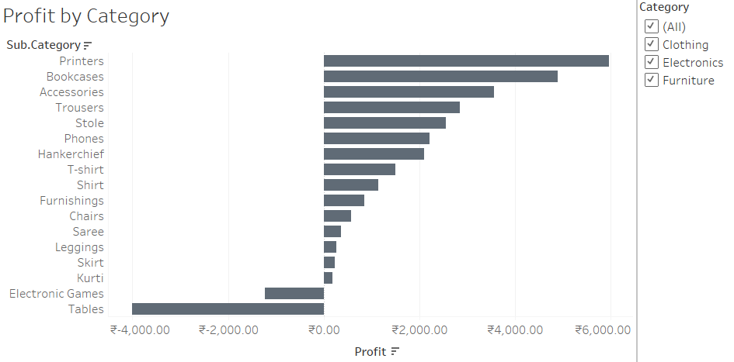
VISUALIZATIONS AND BUSINESS QUESTIONS
Question 4
Which Product brings the highest profit?
The bar graph depicts profit by product category.
We can observe that Printers brings highest profit for the E-commerce company and Table brings loss to the company.

Slide 12
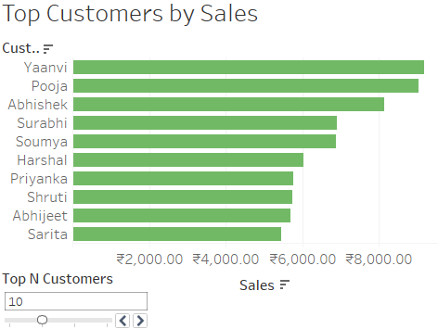
VISUALIZATIONS AND BUSINESS QUESTIONS
Question 5
Show the name of top customers by sales.
The bar graph shows the name of the customers making highest sales.
Using sets and parameters we can also change the view from top 10 to top 20 customers using parameter controls.
We can always adjust the slicer to vary the range of number of customers.
Yaanvi is the top customer by sales.

Slide 13
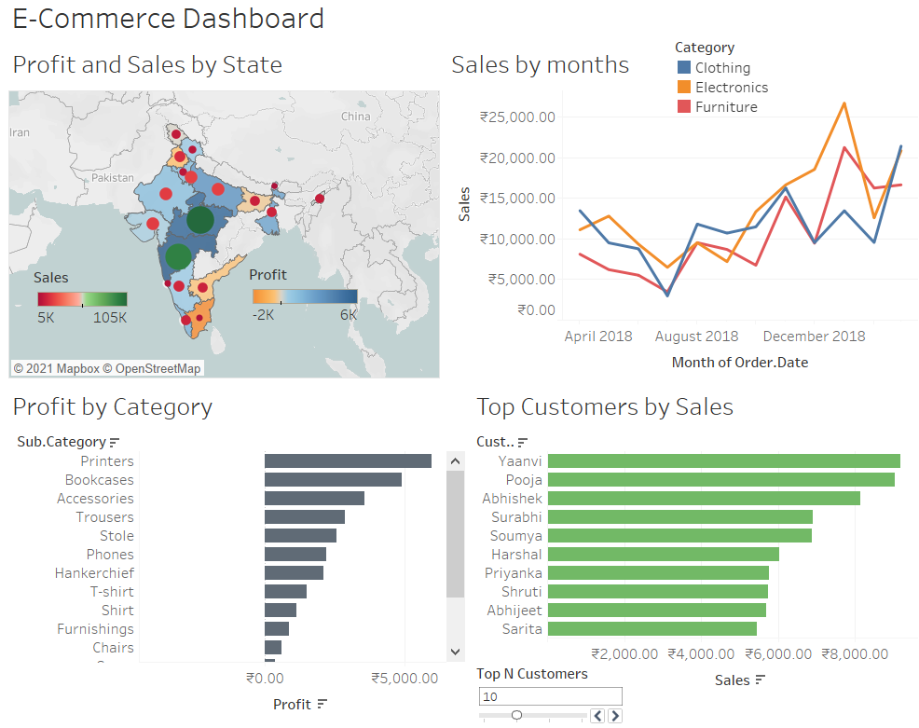

Slide 14


CONCLUSION
Map visualization showed that company receives highest revenue from Madhya Pradesh and Maharashtra.
Line graph displayed that E-commerce company gets highest sales in January.
We observed that there is a weak relationship between sales and profit, With the help of scatterplot matrix.
Printers bring the highest profit for the company.
Yaanvi is our top customer by sales.
Filters, sets and parameters are used to make dashboard interactive.

Slide 15

THANK YOU

